Slide 1
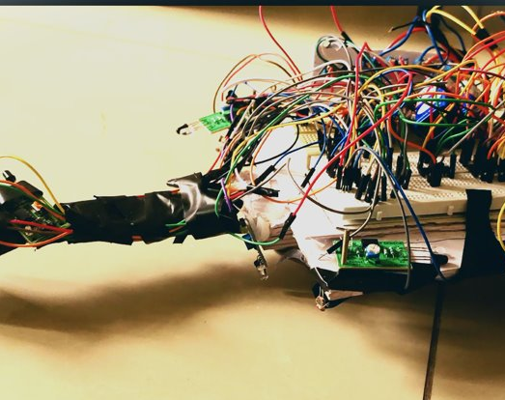
Multi_Bot

Slide 2
Functions:
Multiple functions on same body .
Light Following
Line Following
Edge Avoiding
Obstacle Avoiding

Slide 3
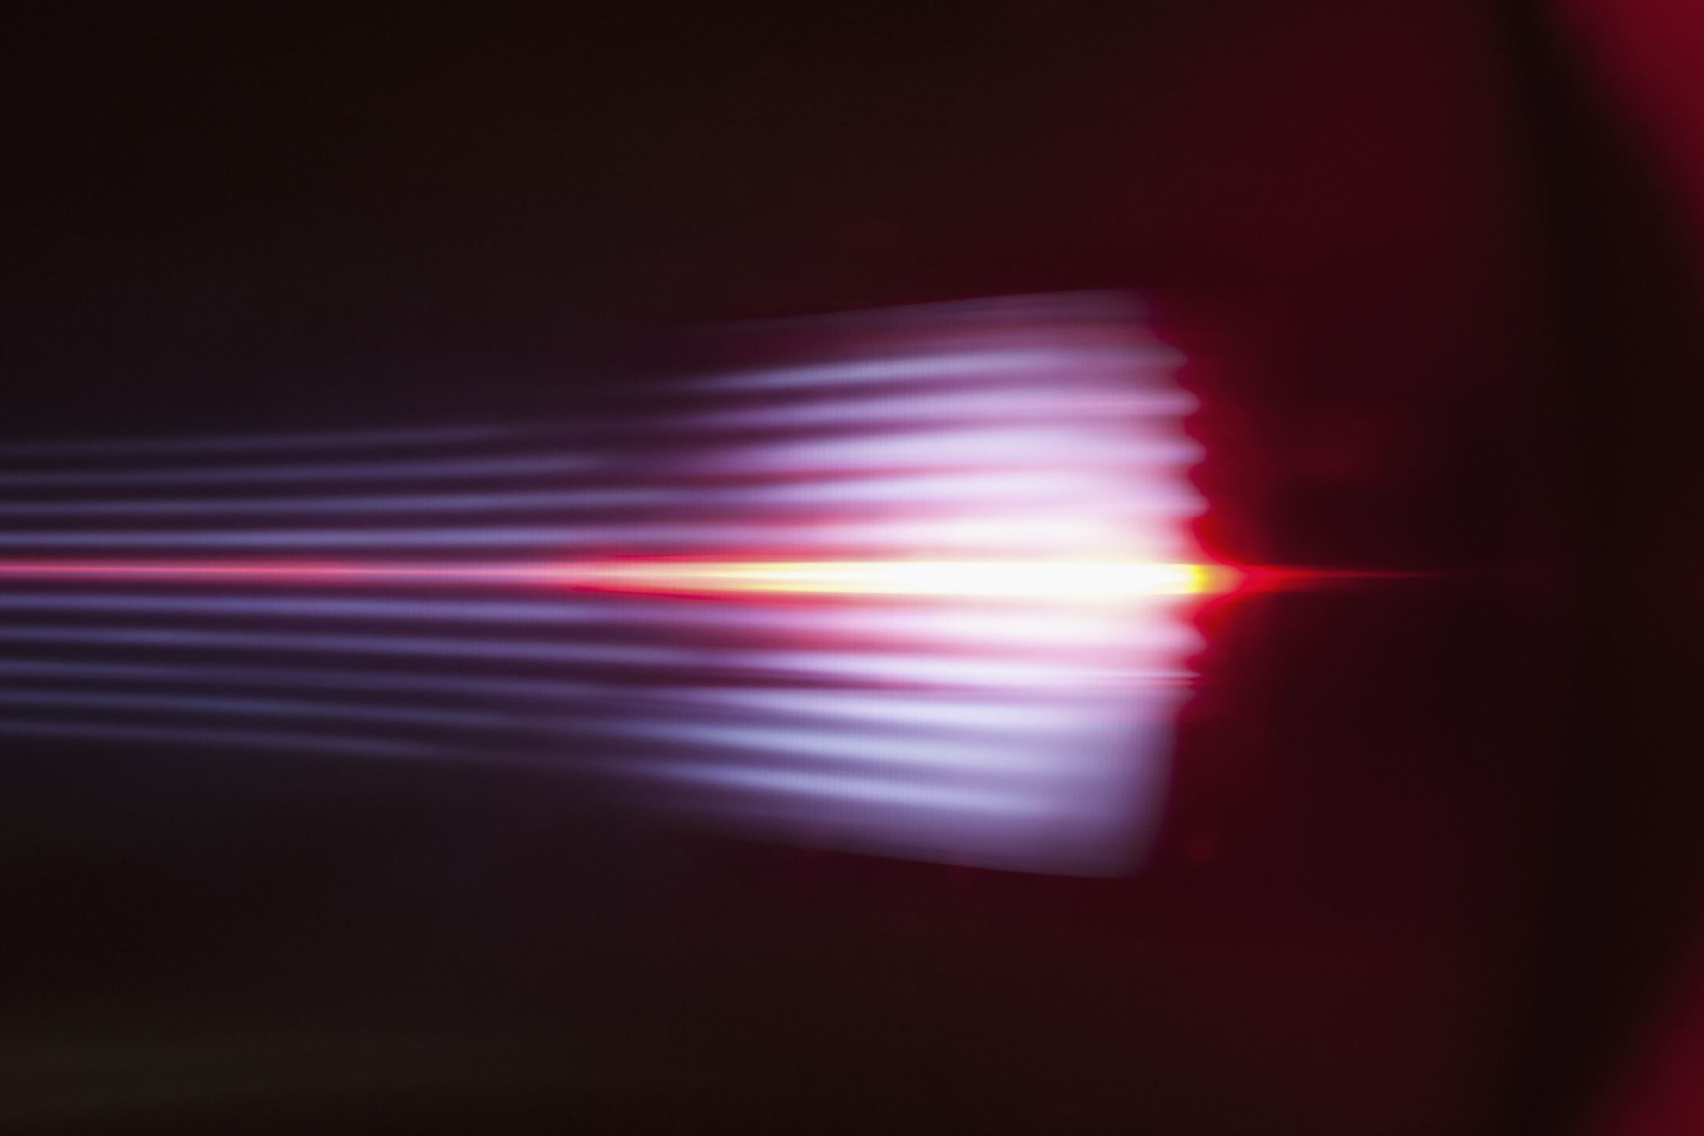
1. Light follower:
Robot senses the light & follows it.
A user can shine a flashlight at its front and it will respond by following the light source.

Slide 4
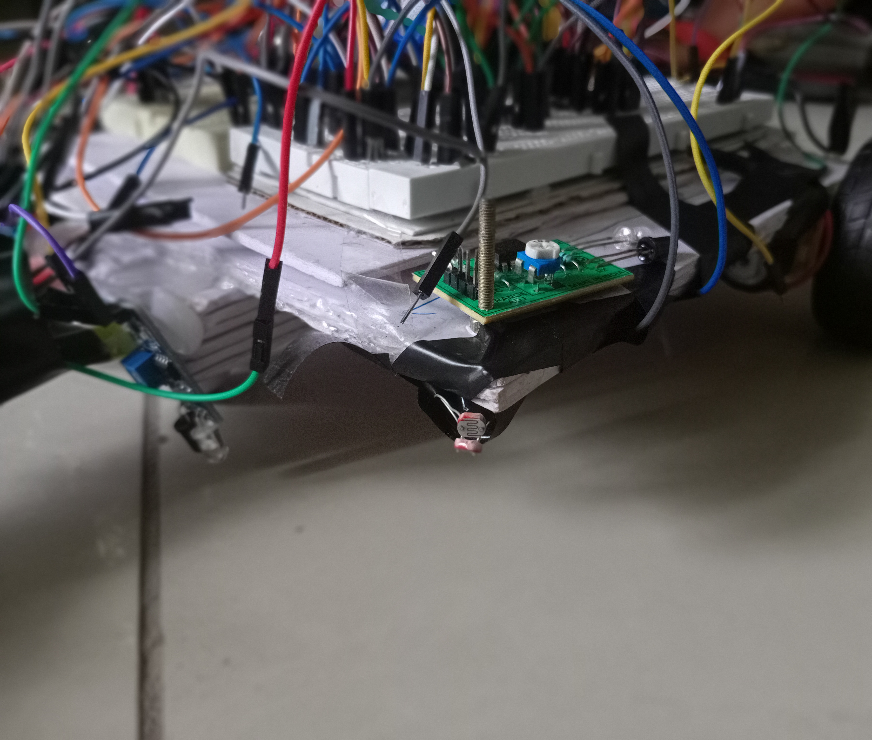
How we achieved it:
LDR :Light Dependent Resistor
On receiving light its resistance decreases and hence more current is supplied to the motor and the robot starts moving.
In our bot , 2 LDR's are located on the front right and front left corner.

Slide 5
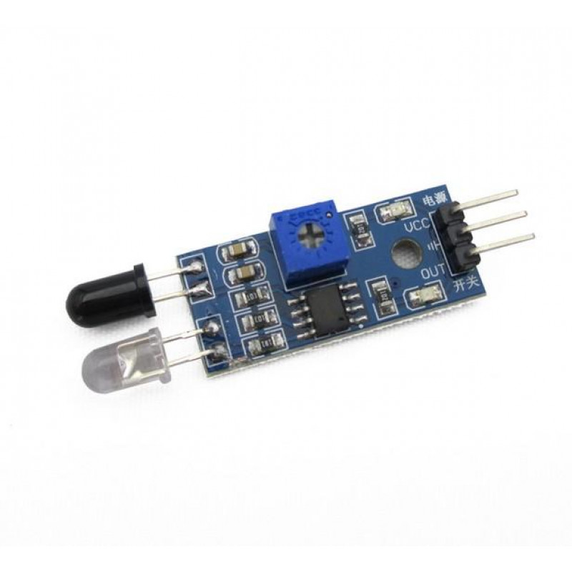
IR sensor:
Receives back the light after getting reflected from any surface in front if any.
Emits infrared light
In next three functions we have used Infra Red sensor.

Slide 6
2. Line follower:
The line follower robot is a simple robot that is based on automation that follows a specific direction based on a particular line, usually a dark line on a light surface.
Black tape on white floor is used to make a path for the robot to follow.
This technology is futuristic in laying automatic railway lines.

Slide 7
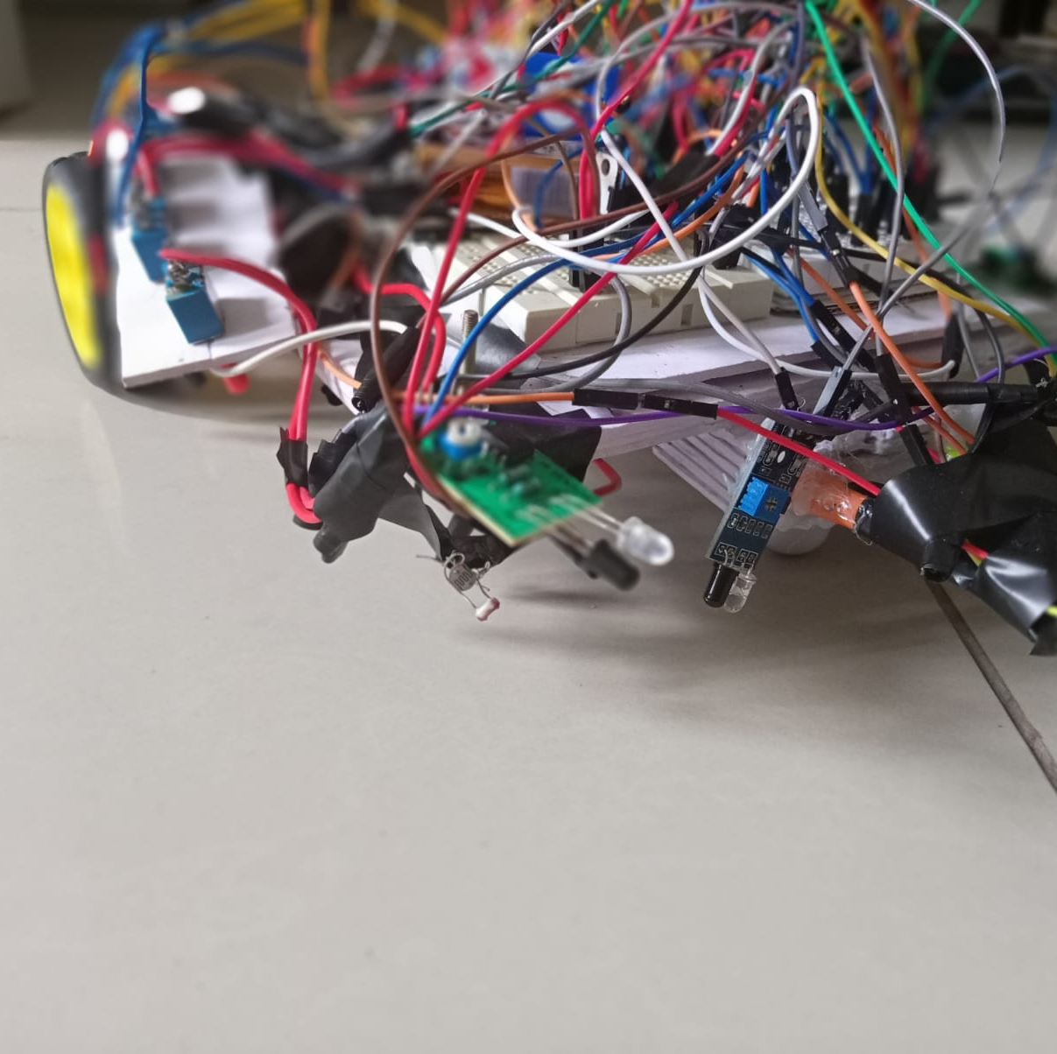
How we constructed it:
Two IR sensors are fixed on the bot in vertical direction facing the ground, adjacent to the 360 degree wheel.
When a sensor encounters the black tape , it receives no light reflected from the ground.
The motor of that side stops and bot get turned in proper path.

Slide 8

3. Obstacle Avoider:
Robot turns back when it detects an obstacle in its path.
It can be used in auto pilot mode in cars.

Slide 9
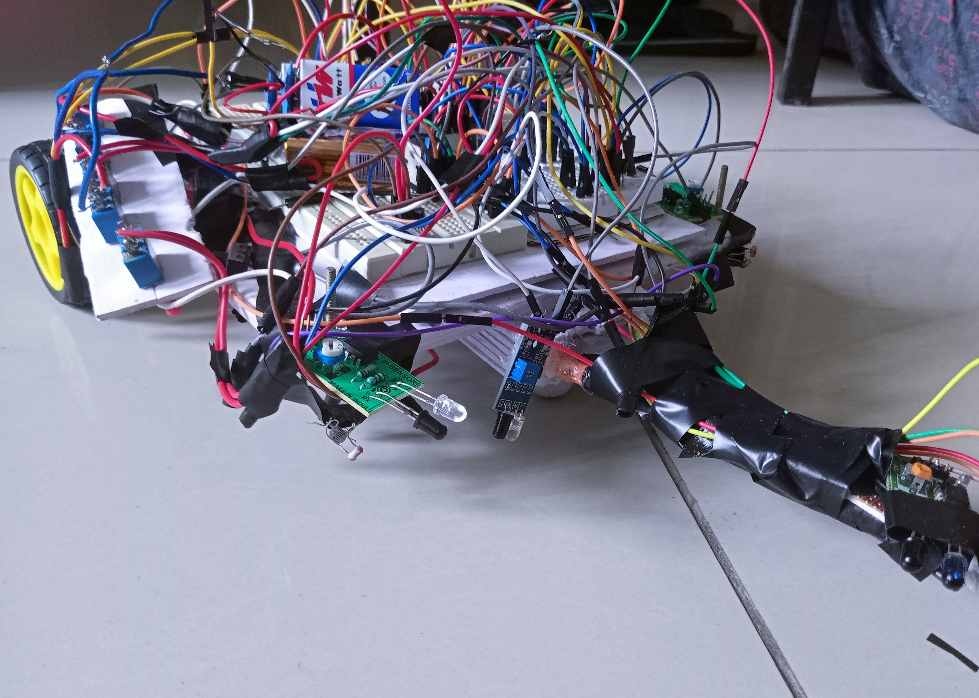
How we made it : 5 such IR sensors are fitted in different orientations to detect an obstacle.

Slide 10
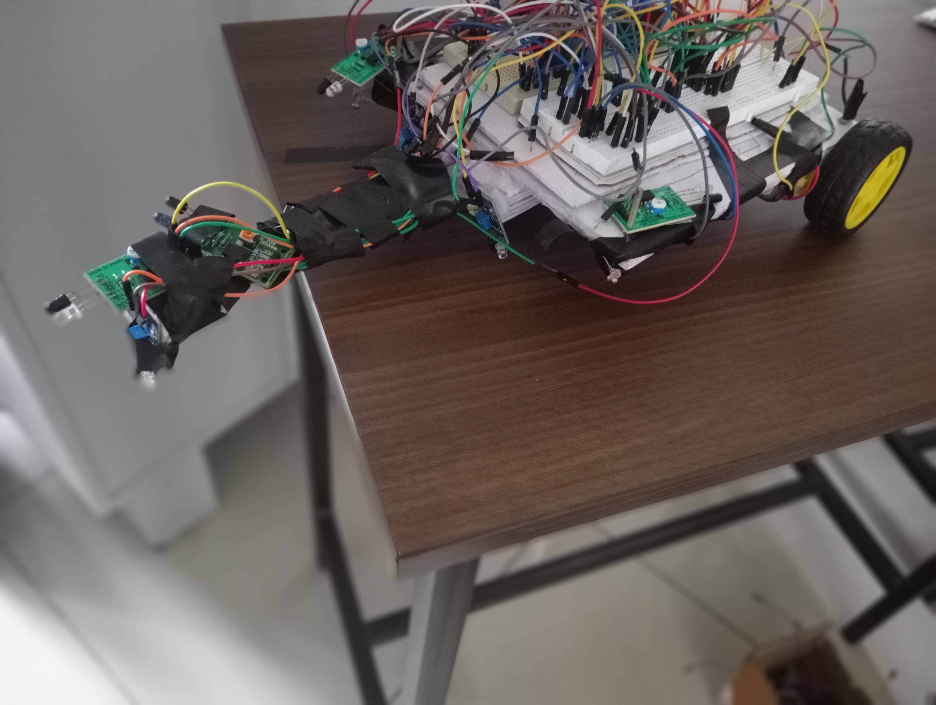
4. Edge avoider:
Robot turns back when IR sensor detects an edge.
In making machines used in construction buildings on the roof.

Slide 11
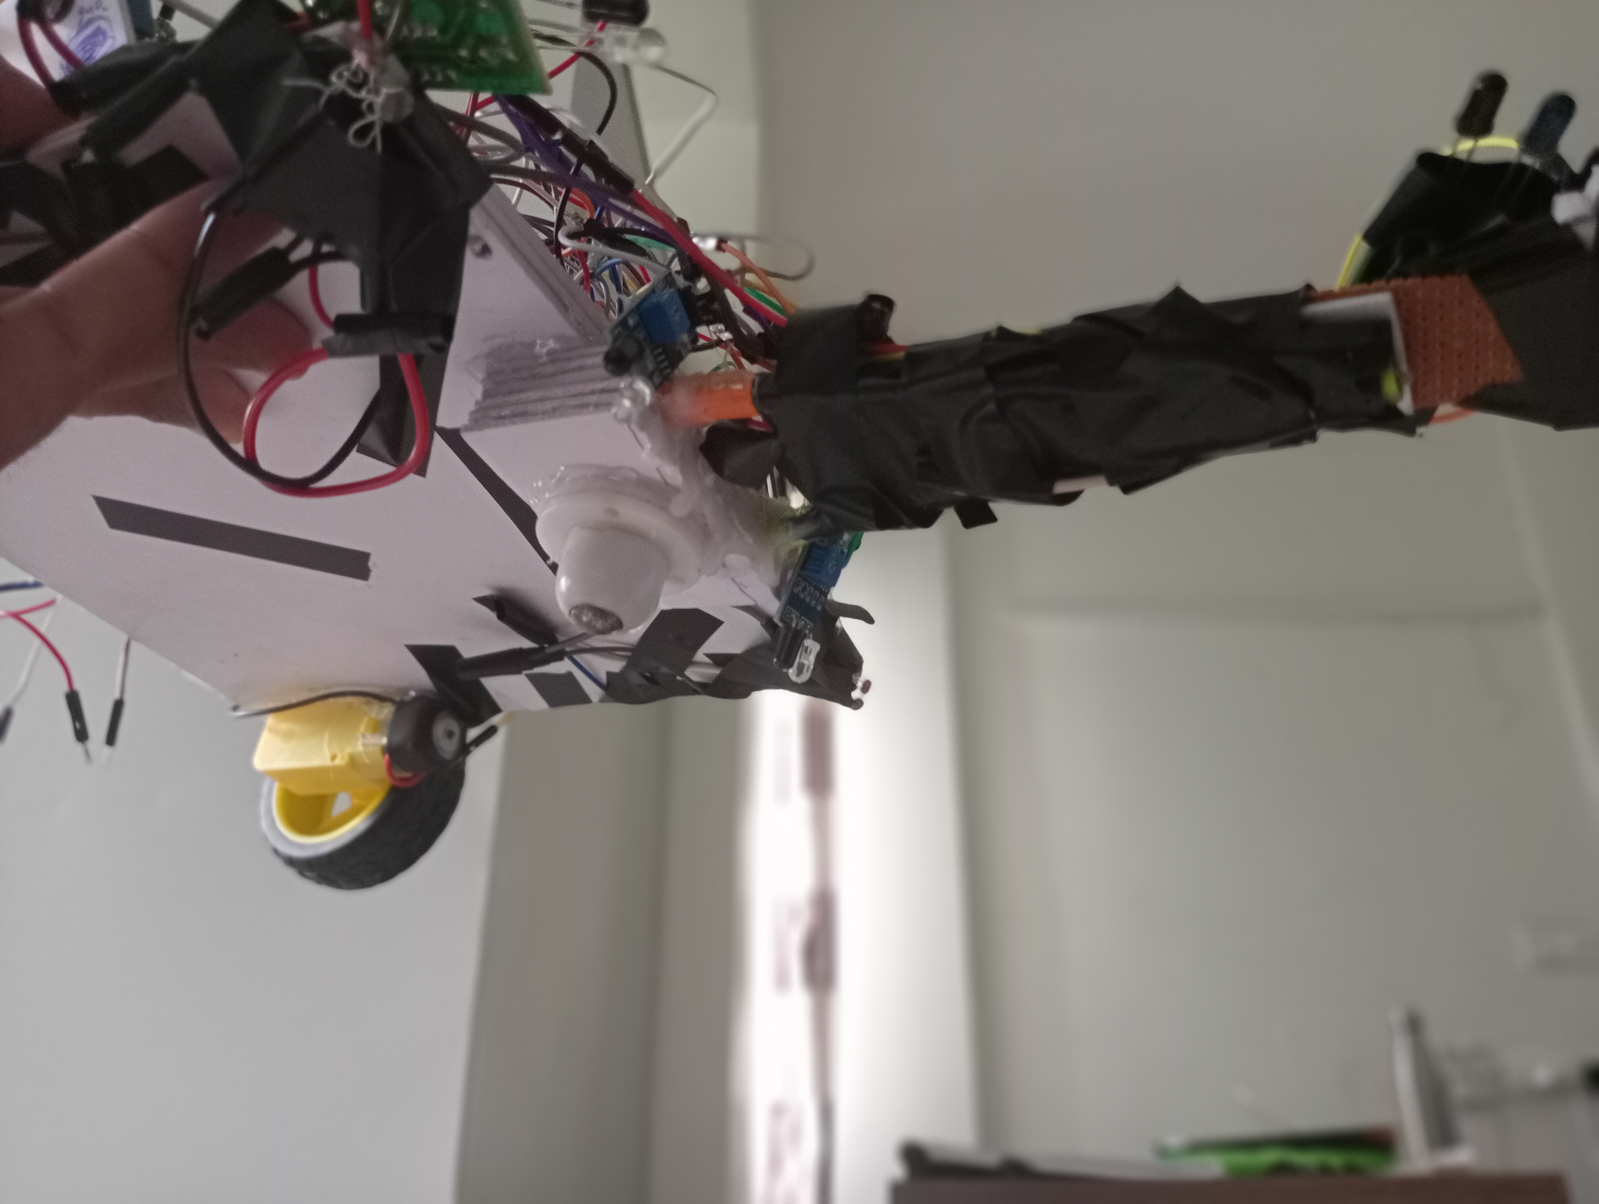
360 degree wheel:
To provide smooth turning even in small area , we used one 360 degree wheel in front along with two geared motors on back.

Slide 12
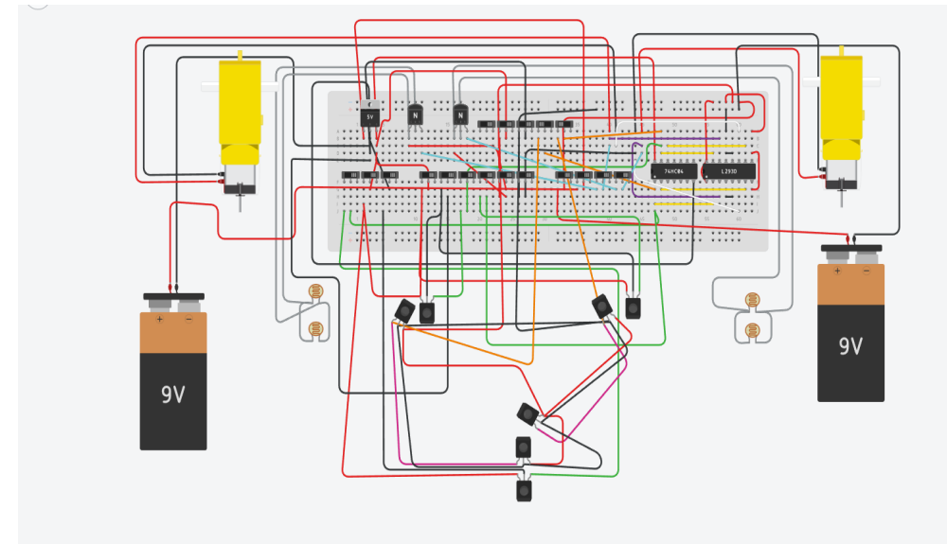
Circuit Diagrams:

Slide 13
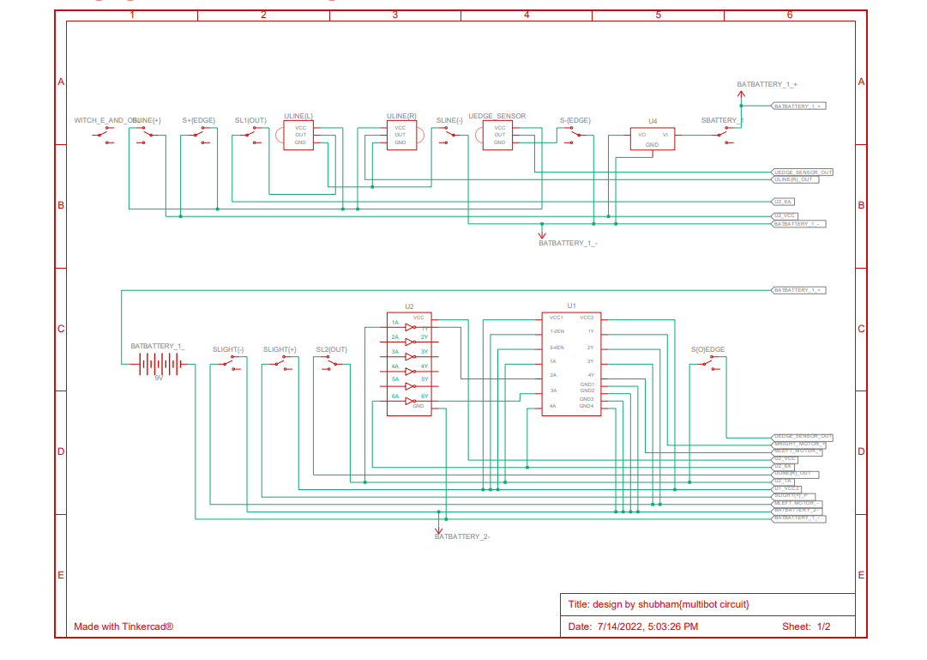
Schematic:

Slide 14
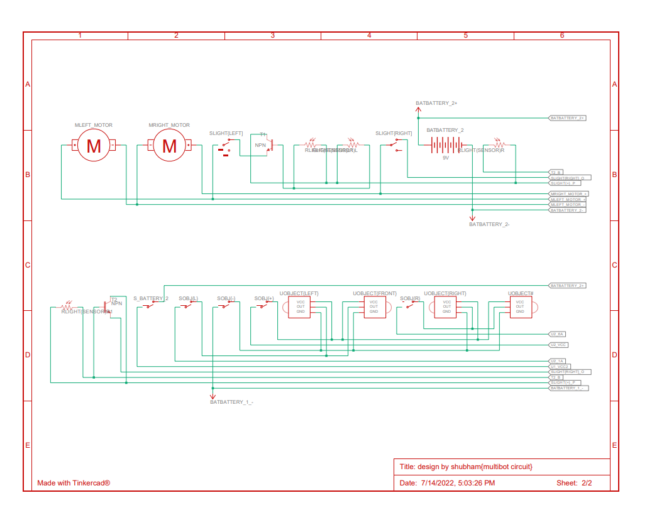

Slide 15
The most interesting and challenging part of our project was to fix bugs. In spite of having right circuit connections and design, many times a functions doesn't worked in the development process, cause of wrong orientation of sensors or something like that. Many a times a single wrong connection resulted in wrong output.
But overall, we enjoyed the process.
All these functions can be applied in real life, for which we need to incorporate AI and a lot more research is needed.

Slide 16
Thank You -G3
Shubham Choudahary
Ujjawal Rai
Swaran Pratap Singh
Soumyadip Mandal
Ujjawal Kumar
Sai Sahasra Surkanti

